Slide 1

A mobile health monitoring-and-treatment system based on integration of the SSN sensor ontology and the HL7 FHIR standard
By: Mennatullah Mahmoud 18101713

Slide 2
Introduction
In 2008 diabetes were responsible for 63% of all deaths all over the world.
It is important to know that the most serious type of DM is type 1 (T1D).
People with T1D need to check their glucose level several times per day, called continuous glucose monitoring (CGM).
Mobile Health (MH) improves well-being and quality of life by supporting continuous remote monitoring.
A clinical decision support system (CDSS) is a knowledge-based system that can mimic medical experts in data analysis and decision-making.

Slide 3
Proposed Solution
Interoperable MH framework suitable for mobile diabetes monitoring and providing of customized, long-term, and real-time treatment plans (TPs)

Slide 4
Modules of the system
01
02
03
04
Patient module
CDSS module
Every patient has a wireless body area network (WBAN) to collect biomedical signs.
Collects, integrates, and interprets patient data and proposes TPs
Backend module
Services module
Responsible for collecting the patient’s historical data from distributed EHR systems.
Provides a collection of services for patients and physicians including real time guidance, provision of TPs, and emergencies

Slide 5
01
Patient module

Slide 6
Goals
Semantic interoperability
WBAN
WBU
Responsible for collecting a patient’s sensed data and dispatching them for further processing
ISO/IEEE 11073 family of standards is used as an open standard for message formatting and as communication protocol between the WBAN and the WBU
Message receiver
Message transformer
Message sender

Slide 7
02
Cloud-based CDSS module

Slide 8
CDSS Engine
Define T1D treatment elements
Identify FHIR resources and profiling
Determine SSN classes and map them to BFO
Patient data are collected automatically from three main sources:
WBAN
distributed EHR systems
data manually sent by the patient
Most features required to build custom treatment plans are imported from an FHIR model, including who, why, what, where. Utilization of about 23 resources to build complete plans
This knowledge is related to modeling WBAN components. The main idea is to annotate sensor data with spatial, temporal, and thematic semantic metadata.
Map resources to SSN and BFO
Model resources knowledge with OWL constructs
Model T1D treatment knowledge with FHIR resources
All selected resources are modeled as subclasses or equivalent classes to either SSN classes or BFO universals. which improves the portability, shareability, reusability, and customizability of the resulting knowledge.
They extend the semantics of SSN in a standard way based on FHIR semantics. Medical, location, and temporal concepts are linked to SSN knowledge. Moreover, we model the FHIR semantics for the other non-sensor EHR data and relate this knowledge to SSN concepts
The resulting ontology is rich enough to define any type of TP for diabetics. A TP has three main sub-plans:
medication for insulin prescription
lifestyle for diet and exercise
education for defining custom learning topics

Slide 9
03
Backend module

Slide 10
04
Services module

Slide 11
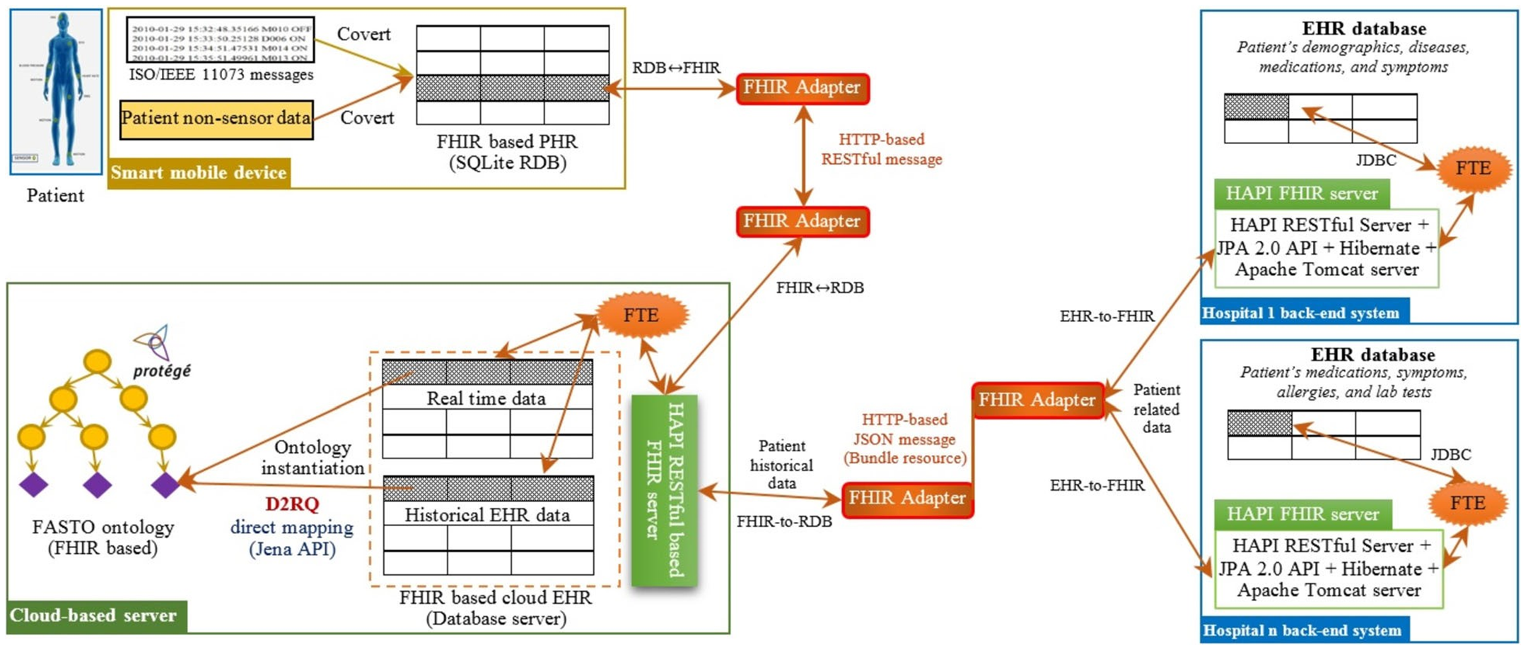
This Is a Map

